Slide 1
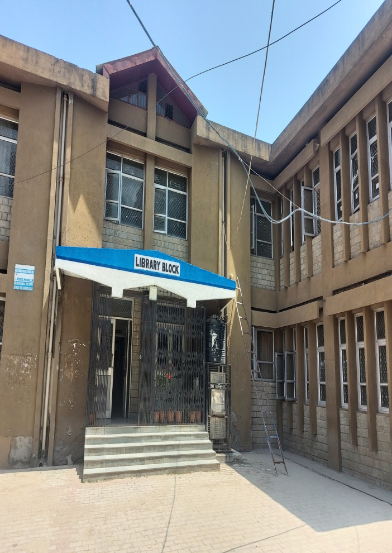
Welcome
To
Dr. Bhim Rao Ambedkar Library Vallabh Govt. P.G. College Mandi H.P.

Slide 2
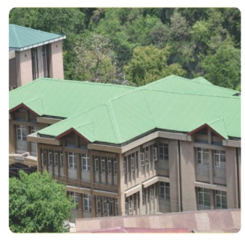
About The Library
Vallabh Govt. College Library is the one of the oldest Libraries in Himachal Pradesh and is part of the institution since its inception in 1948.
Library has a rich collection of Books on Various Branches of Knowledge.
About 39000 collection of Books are housed in the Library.

Slide 3
Vision of the Library
To Serve as a Knowledge Hub of the College
To Inculcate Reading Habits among the Students and Teaching Community.
To Help Students to Enrich their Knowledge to achieve their goals and Create better world for themselves.

Slide 4
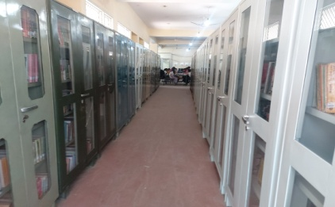
Objectives of the Library
Inculcate reading habits among students and Teaching Community.
Provide accessibility to information in a well-organised and coherent manner.
Provide facilities and services for Students and Staff to discover needed information and use then according to their use.
Develop an effective and efficient college library which is adaptable to changing academic environment.

Slide 5
Rules of the Library
No Student is allowed to enter the library without Identity Card.
Two books are issued at a time for a period of one month but the librarian has a right to recall the books.
A fine of Rs.1/- per book per day will be charged beyond the due date.
Books are also issued to SC/St/Low income group on the recommendation of the tutor.
Reference books are not issued. They can be consulted in the library after obtaining permission from the librarian.
In case of loss of a book one have to replace the book or pay fine in addition to the present price of the book with special permission of the Principal.

Slide 6
Library Hours
Monday to Saturday 10.00 AM - 5.00 PM
Books Issue/ Return Timings 10.15 AM - 4.00 PM
During vacations reading room facility is provided to students.
Closed on public holidays.

Slide 7
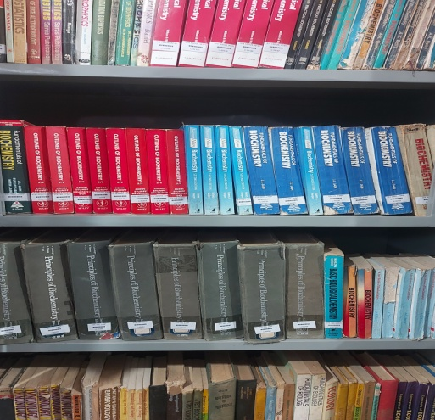
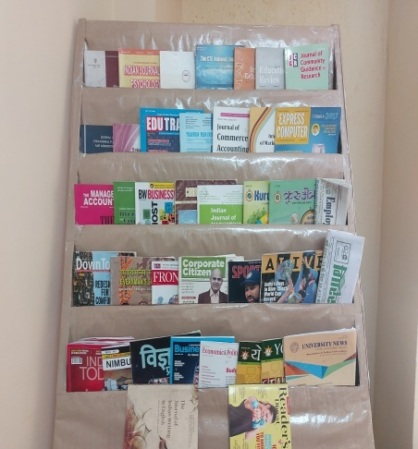
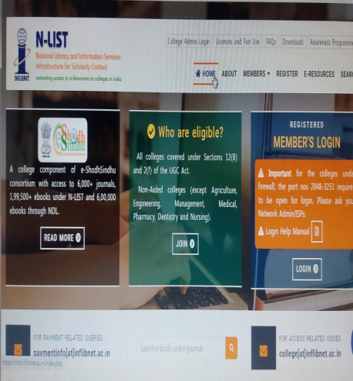
Library Collection
Books
Newspapers
Journals/ Magazines
Electronic Resources (E-Journals)

Slide 8
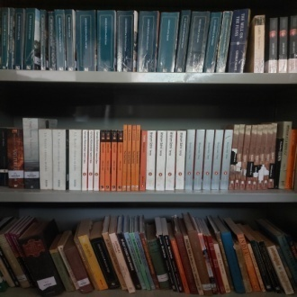
Library Collection - Books
College Library has a rich collection of 51390 Accessioned Books - purchased out of different funds such as :- Government Fund, UGC Fund, Amalgamated Fund, Star College Scheme Fund, Evening College Fund, HIES Fund (B.Ed., BBA, BCA, PGDCA).
In addition to it Library collection also includes around 200 gratis books.
More than 38300 volumes of books are available for circulation.

Slide 9
Library Collection – Reference Books
Reference Section of Library contains a good collection of information-dense resources, such as Encyclopaedias, Dictionaries of Different Subjects, Thesauri, Atlases, Year Books, Vedas, Puranas and other reference handbooks. Many old and out of print books which are more than sixty years old are available in the Library.

Slide 10
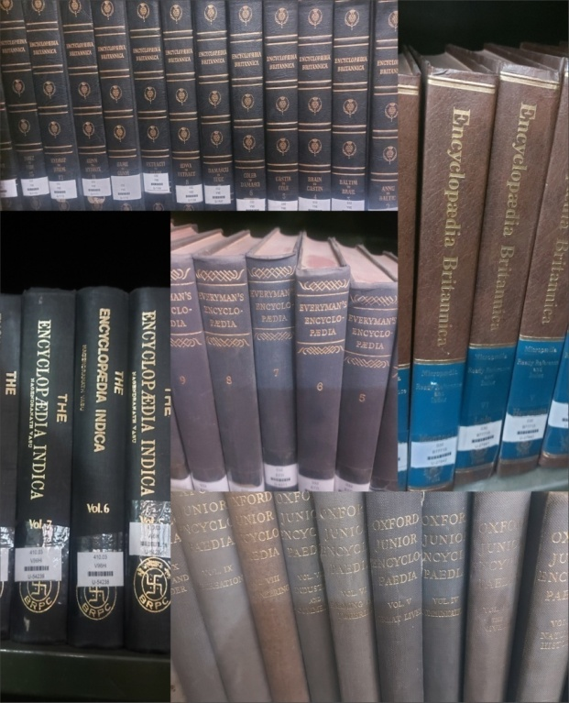
Encyclopedias Available in the Library
Encyclopaedia Britannica 2 sets 30Vols 1973-74
Oxford Junior Encyclopaedia
Everymen’s Encyclopaedia
Van Nostrand’s Scientific Encyclopaedia
Hutchinson’s Twentieth Century Encyclopaedia
The Columbia Encyclopaedia
The Great Encyclopaedia of Universal Knowledge
Encyclopaedia of Social Sciences
International Encyclopaedia of Social Sciences
McGraw Hill Encyclopaedia of World Bibliography
The New illustrated Everyman Encyclopaedia
Encyclopaedia of world Art
Cyclopedia of English Literature
Illustrated World Encyclopaedia
The Macmillan Encyclopaedia
New Standard Encyclopaedia
Encyclopaedia of Philosophy
Encyclopaedia Indica

Slide 11
Encyclopedias Available in the Library
Encyclopaedia of Child and Primary Education Development (3Vols)
Encyclopaedia of Modern Education Techniques and Methodology (5Vols)
Encyclopaedia of Philosophical and Sociological Foundation of Education (2Vols)
Encyclopaedia Of Educational Research (4Vols)
Encyclopaedia of Education ((7Vols)
Encyclopaedia of Fundamental of Educational Psychology (3Vols)
Encyclopaedia of Education & Technology (2Vols)
Encyclopaedia of Education (4Vols)
Encyclopaedia of Physical Education (5Vols)
Encyclopaedia of Educational Technology (4Vols)
Encyclopaedia of Teaching Physical Science (3Vols)
Encyclopaedia of Education and Technology (3Vols)
Encyclopaedia of World’s Great Educational Thinkers (2Vols)
Encyclopaedia of World Great writers (2Vols)
Encyclopaedia of Teacher Education (2Vols)
Encyclopaedia of Education, Culture and Children Literature (4Vols)
Encyclopaedia of Education System in India (12Vols)
Encyclopaedia of Higher Education in 21st Century (3Vols)
Encyclopaedia of Educational Problems (2Vols)
Encyclopaedia of Primary Education (5Vols)
Encyclopedic Dictionary of Education (2vols)

Slide 12
Library Collection – Books (Fund Wise)
FUND | TOTAL BOOKS | WITHDRAWN | TOTAL IN STOCK
Government Fund | 16098 | 5948 | 10150
Boys Fund | 10999 | 2088 | 8910
UGC Fund | 17142 | 4481 | 12661
Evening Fund | 1340 | 654 | 687
PF | 108 | 4 | 104
Star College Fund | 1064 | 11 | 1053
BBA | 657 | 23 | 634
BCA | 348 | 6 | 342
B.Ed | 3668 | 21 | 3647
PGDCA | 87 | 0 | 87
TOTAL | 51511 | 13236 | 38275

Slide 13
Library Collection: Subject-wise Distribution of Books
Computer Science | 363
Journalism | 96
Psychology | 212
Sociology | 817
Political Science | 2796
Economics | 2482
Public Administration | 351
Education | 2066
Commerce | 2711
Mathematics | 1472
Physics | 1883
Chemistry | 1627
Botany | 1495
Zoology | 1057
Biotechnology | 747
Retail Mgt. | 18
Applied Arts | 15
Music | 467
Dance | 43
Painting | 14
Physical Edu. | 397
Hindi | 5442
English | 4582
Sanskrit | 1156
Geography | 1070
History | 2097
Biography | 514
Miscellaneous | 2285+200

Slide 14
Library Collections – Arrangement of Books
College follow Dewey Decimal Classification Scheme.
Books are arranged in Classified Order in different sections i.e. Reference Section, UGC Section, Govt. Fund Section, A/F Section, Star College Fund Section, B.Ed. Section, BBA, BCA, PGDCA Section.

Slide 15
Library Collections – Newspapers
Newspapers are the key source of information of current affairs.
It help us to enhance our knowledge on various issues.
Help us to cultivate reading habits.
Our college library has subscribed to 12 daily Newspapers in English and Hindi.

Slide 16
List of Newspapers Subscribed in the College Library
Punjab Kesari
Danik Tribune
Divya Himachal
Amar Ujala
Danik Jagran
Danik Bhaskar
The Tribune
Indian Express
Hindustan Times
The Hindu
Financial Express
Economic Times

Slide 17
Library Collections- Journals / Magazines
Our Library Subscribes to good number of Journals/ Magazines.
Total 14 Journals and 23 Magazines are subscribing to Library at present.
Preference has been given to Interdisciplinary Journals and magazines as well as competitive magazines.

Slide 18
List of Magazines Subscribed by the Library
Employment News weekly
Giriraj weekly
University News weekly
India Today weekly
India Today (Hindi) weekly
Sports Star Fortnightly
Down To Earth Fortnightly
Front Line Fortnightly
Business Today Fortnightly
Business World Fortnightly
Business India Fortnightly
Competition Success Monthly
Review
Competition Success Monthly
Review G.K.
Civil Service Chronicle Monthly
Junior Science Refresher Monthly
Pratiyogita Darpan Monthly
Reader’s Digest Monthly
Science Reporter Monthly
Vigyan Pragati Monthly
Yojna Monthly
Yojna (Hindi) Monthly
Kurukshetra Monthly
Kurukshetra (Hindi) Monthly

Slide 19
List of Journals Subscribed by Library
1.Journal of Commerce and Accounting Research (4 issue/year)
2. International Journal of Marketing and Business Communication (3 issue/year)
3. Prabandhan : Indian Journal of Management (Monthly)
4. Indian Journal of Marketing (Monthly)
5. Economic and Political Weekly (Weekly)
6. Edutraks (Monthly)
7. Journal of Community Guidance and Research (Quarterly)
8. CTE National journal Quest for Excellence in Teacher Education (Half Yearly)
9. Indian Journal of Psychology and Mental Health
10. Journal of All India Association for Educational Research (Half Yearly)
11. Bhartiya Adhunik Shiksha (Quarterly)
12. Indian Educational Review (Half Yearly)
13. Journal of Indian Education (Quarterly)
14. School Science (Quarterly)

Slide 20
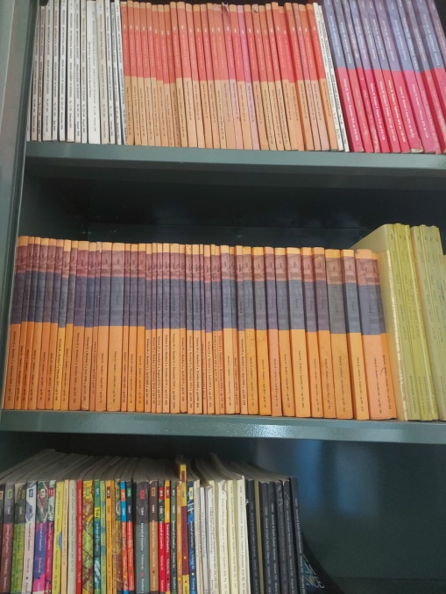
Library Collections – Journals Back Issues
Proceedings : Mathematical Science
Bulletin of Material Science
Sadhana: Academy Proceedings in Engineering Science
Journal of Earth System Science
Journal of Biosciences
Indian Journal of Biotechnology
Journal of Genetics
Current Science
Pramana: Journal of Physics
Journal of Astrophysics and Astronomy
Journal of Chemical Science
Resonance: Journal of Science Education
International Journal of Information Dissemination and Technology
Indian Journal of Information Science and Computer Application
Express Computer

Slide 21
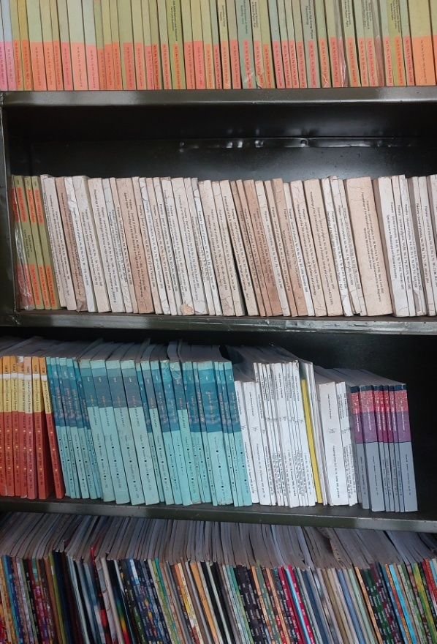
Library Collections – Journals Back Issues
Ruminations: A Peer Reviewed Bio-Annual International Journal for Analysis and Research in Humanities and Social Science
Sociological Bulletin
South Asian Survey
Applied Economics and Econometrics
The Journal of Indian Writing in English
The Literary Criterion
JELL: Journal of English Literature and language
Indian Journal of American Studies
Samkalin Bhartiya Sahitya (Hindi)
Aalochana (Hindi)
Management and Accounting Research
IIMB Management Review

Slide 22
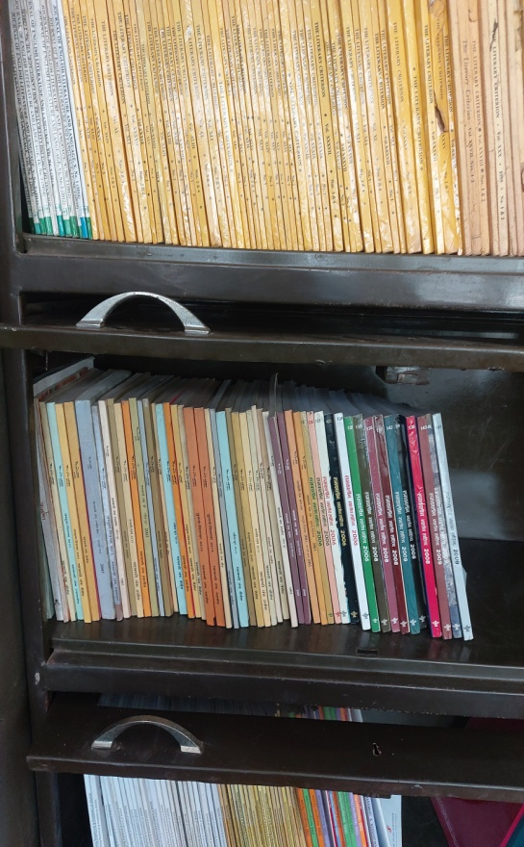
Library Collections – Journals Back Issues
Journal of Commerce and Accounting Research
The Management Accountant
The Chartered Accountant
Prabandhan: Indian Journal of Management
Indian Journal of Marketing
Edutracs
Indian Journal of Teacher Education: Anweshika
Journal of Community Guidance and Research
Journal of All India Association for Educational Research
Journal of Educational Planning and Administration
Indian Educational Review
Teacher Support
Psycho Lingua
Indian Journal of Psychology and Education
Journal of Indian Education
Bhartiya Aadhunik Shiksha (Hindi)
The CTE National Journal: Quest for Excellence in Teacher Education

Slide 23
Library Collections – Electronic Resources N-LIST
Our Library is a part of the N-LIST Program and has obtained the membership to access N-LIST Electronic Resources. Students and Faculty Members can have access to Electronic Resources through INFLIBNET N-LIST Program.

Slide 24
N-LIST E-Resources
E-Journals | Titles
American Institute of Physics | 18
Annual Reviews | 33
Economic and Political Weekly | 1
Indian Journals | 180+
Institute of Physics | 46
JSTOR | 2500+
Oxford University Press | 262
Royal Society of Chemistry | 29
W. H. Wilson | 3000
Cambridge University Press | 224
E-Books | Titles
Cambridge Books Online | 1800
E-Library | 185000
EBSCoHost-Net Library | 936
Hindustan Book Agency | 65+
Oxford Scholarship | 1402+
Institute of South East Asian Studies Books | 382+
Springer E-books | 2300
Sage Publication E-books | 1000
Taylor Frances E-books | 1800
Myilibrary Mc-Graw Hill | 1124

Slide 25
Library Services Provided
Following Library Services have been providing for the Students and Staff:
Circulation Service
Reference Service
Book Bank Facility
Xerox Facility
Internet Facility
Weeding Out
OPAC (Online Public Access Catalogue)

Slide 26
Library Services - Circulation
Lending Service to Students and Staff:
User No. of Books Time period
Students 2 Books One Month
Faculty 10 Books One Year
Staff 5 Books One year

Slide 27
Library Services - Circulation
Circulation is fully Automated using SOUL3.0 Software of INFLIBNET.
All the books have been Bar-coded.
All students are issued bar-coded Library Cards. After completing the admission process at the beginning of the academic year students can download their Identity Cards from the college website by logging in their account.
Staff Members have also been issued Bar-coded Identity Cards.

Slide 28
Library Services - Reference Service
Our Library have a good collection of reference materials such as Encyclopedias, Dictionaries, Thesaurus, Yearbooks, General Studies Manuals, Atlases, etc.
Whenever there is an information need for students and faculty, Library Staff are helping them to find and use it.

Slide 29
Library Services – Book Bank Facility
Book Bank Facility is one of the important facility for students coming from underprivileged sections of the society.
Our college provides book bank facility for SC/ ST/ OBC/ IRDP Students.
Books are issued to these Students for the year at the beginning of the Session/ Semester on the recommendation of the Book Bank Committee .

Slide 30
Library Services – Xerox Facility
Xerox facility is provided to Students and Staff in the Library.

Slide 31
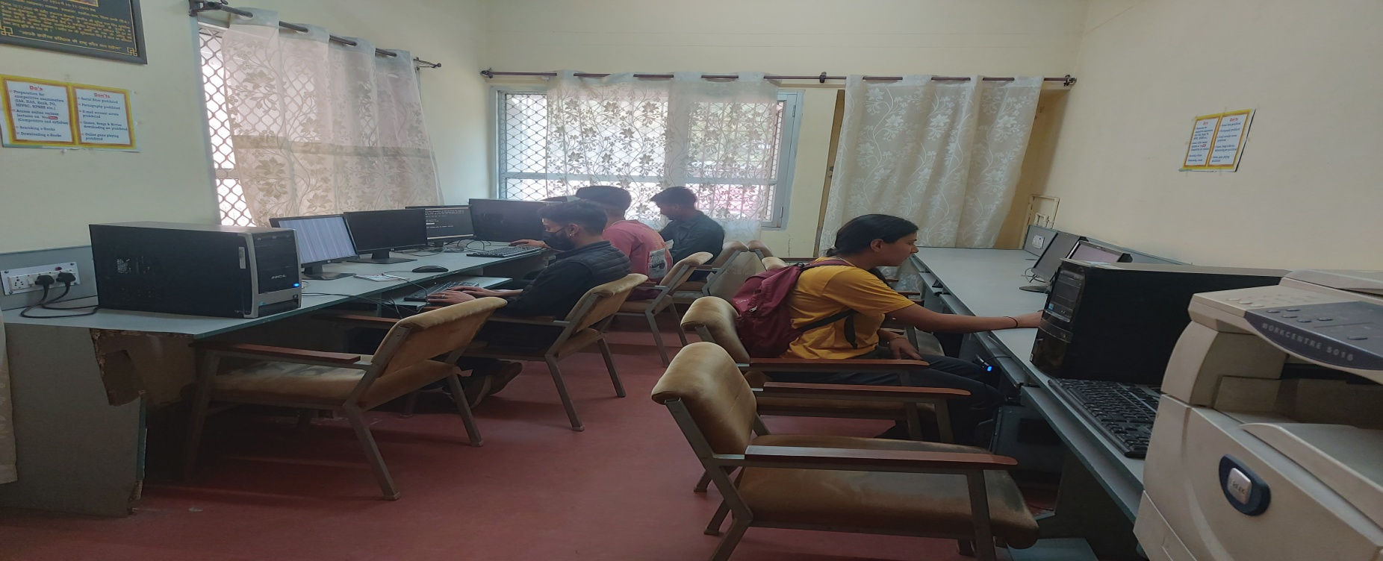
Library Services – Internet Facility
Students and Staff can access N-LIST and other electronic resources on the systems installed in Library Computer Center.

Slide 32
Library Services – Weeding Out Policy
We follow the Government guidelines and rules to write off the unserviceable books and other materials.
Every year at the time of Stock Verification, brittle, old and out of syllabus unused books will be identified and report with cost analysis will be prepared to write off the same in consultation with the Library Advisory Committee.

Slide 33
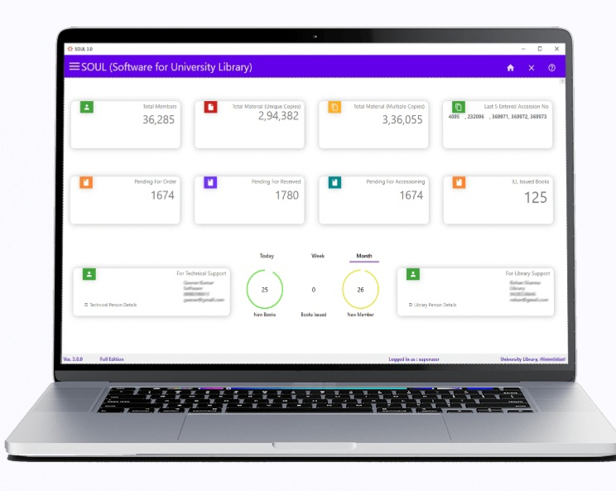
Library Best Practices – Library Automation
Our Library uses the Library Management Software SOUL3.0 developed by Information Library Network (INFLIBNET) Ahmedabad.
At present Circulation is fully automated.
OPAC can be consulted on the systems attached through LAN in the Library.
WebOPAC is available
through Internet / College
Website and can be consulted
24*7 on any device.

Slide 34
WebOPAC Search Interface

Slide 35
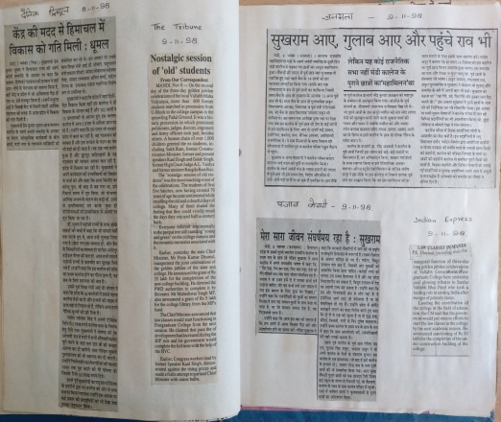
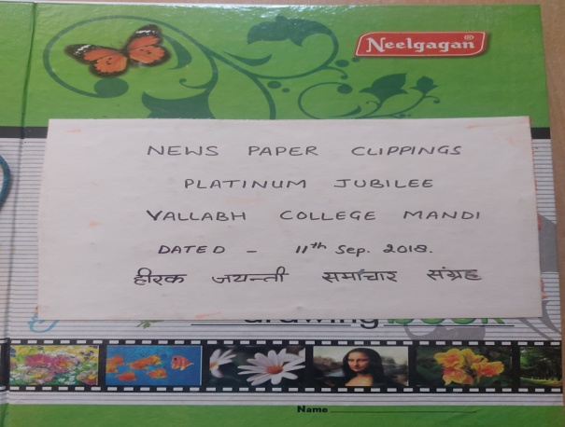
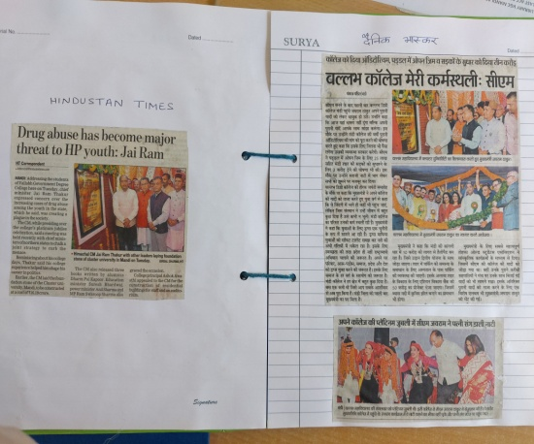
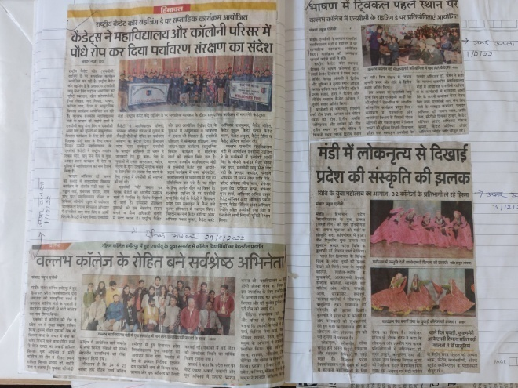
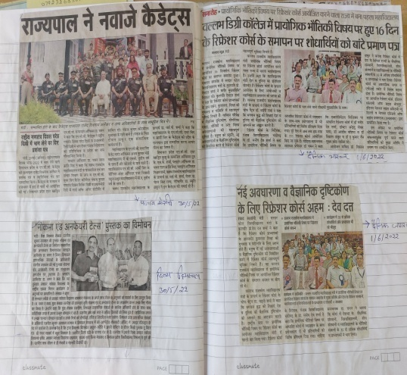
Newspaper Clippings
Our Library collects Newspaper Clippings related to our institution for future reference

Slide 36
Library Staff
Designation | Name
Librarian | Vacant
Assistant Librarian | Kavita Malhotra
Assistant Librarian HEIS | Hem Nalini
Library Attendant HEIS | Mohini Devi
Library Attendant HEIS | Narbada Devi
Part Time Contingent | Lata Devi

Slide 37
Assistant Librarian
Kavita Malhotra
Master’s in Library and Information science
Diploma in Information Technology

Slide 38
Assistant Librarian HEIS
Hem Nalini
Master’s In Library and Information science

Slide 39
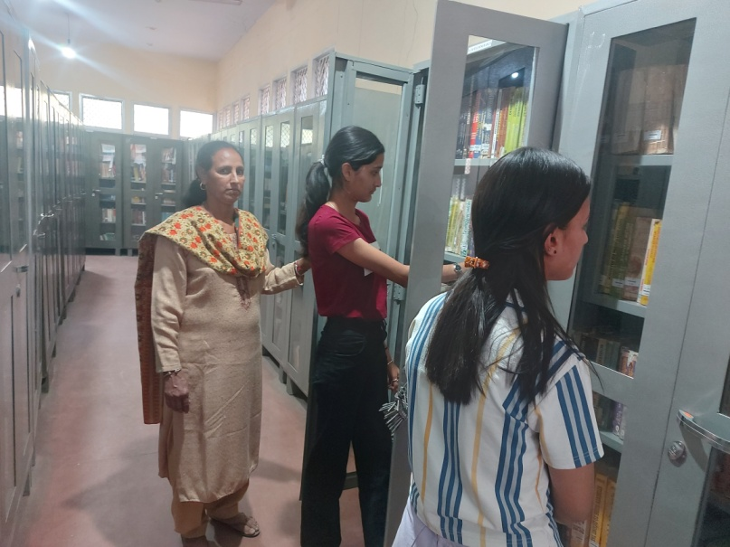
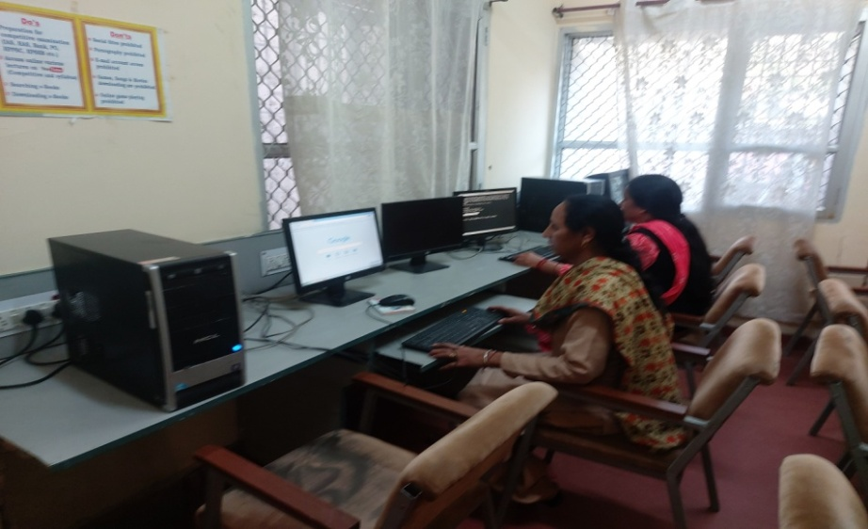
Library Resources

Slide 40
Students Reading in Library

Slide 41
Staff At Work

Slide 42
Thankyou !!

